Slide 1


Game Pitch:
Drums of War
Justin Yip
Isaac Lee
Chung Wei Qi

Slide 2

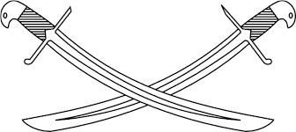
What is “Drums of War”
Single Player Side Scrolling War Game
Player commands their army by a sequence of drum beats
Starts from the left side of the level, ends at the right.
Many Enemies and other Obstacles in the way
2D

Slide 3

Technical Information
Target platform: PC, Android (mobile)
Distribution platform: Steam, Google Play
Monetization: Digital Distribution

Slide 4
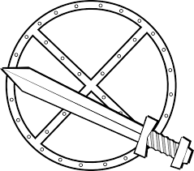
Unique Selling Point
Not many of such games on App Store or on PC
Easy to learn, hard to master
Able to customize your army to suit the battle

Slide 5

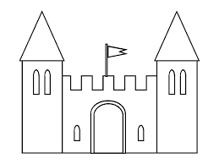
Gameplay
Player’s Army starts at the left
Players are given four different drum beats
Drum 4 beats over 2 seconds in rhythm
Different Sequences give different results
Units automatically attack enemy, influence their actions with your beats.

Slide 6

Level Design
The base game will contain 17 levels
  Only level 1 is unlocked initially
  Completing a level will unlock the next level(s)
Replaying the level will be may be different in objectives
  More or less enemies
  Rescuing people from the enemy
  Escort a caravan to the end
New maps may introduce new features

